Slide 1
Non-Vitamin K Antagonist (NOAC)
Oral Anticoagulants in Patients with
Atrial Fibrillation
Prof. Dr. Dursun Aras
Medipol Üniversitesi Tıp Fakültesi
Medipol Bahçelievler Hastanesi
İSTANBUL

Slide 2
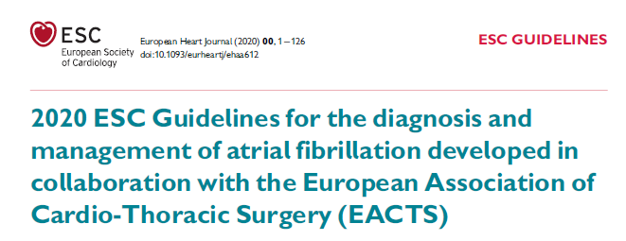

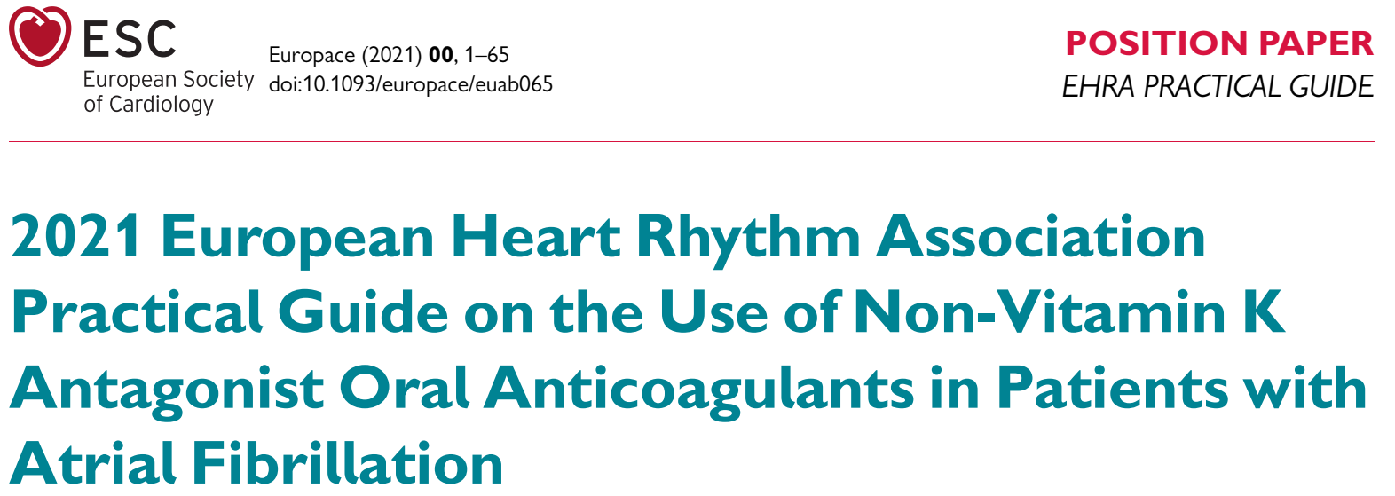
NOAC

Slide 3
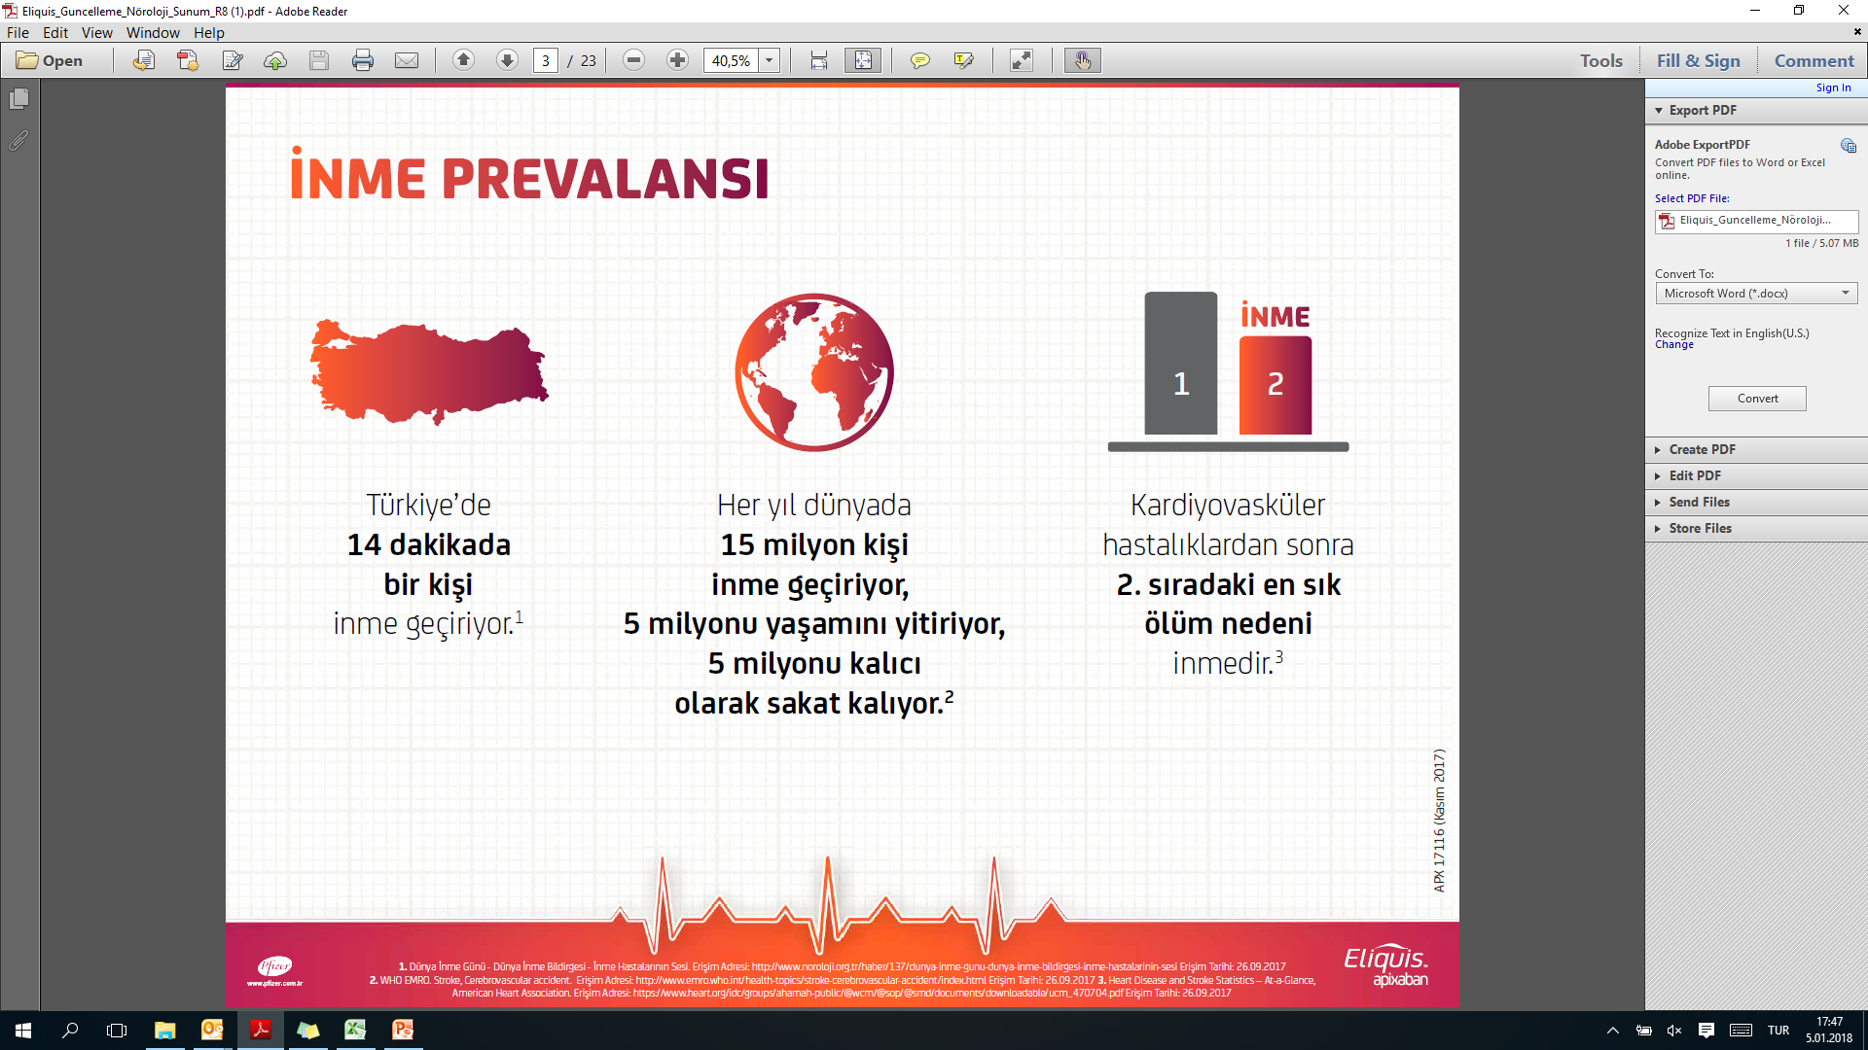


Stroke tüm ölüm nedenleri içinde
2. sıradadır¹
3
1. Heart Disease and Stroke Statistics – At-a-Glance, American Heart Association. Erisim Adresi: Erisim Tarihi: 26.09.2017
https://www.heart.org/idc/groups/ahamah-public/@wcm/@sop/@smd/documents/downloadable/ucm_470704.pdf 2. WHO EMRO. Stroke, Cerebrovascular accident. Erisim Adresi: http://www.emro.who.int/health-topics/stroke-cerebrovascular-accident/index.html Erisim Tarihi: 3. Dünya Inme Günü - Dünya Inme Bildirgesi - Inme Hastalarının Sesi. Erisim Adresi:http://www.noroloji.org.tr/haber/137/dunya-inme-gunu-dunya-inme-bildirgesi-inme-hastalarinin-sesiErisim Tarihi: 26.09.2017

Slide 4
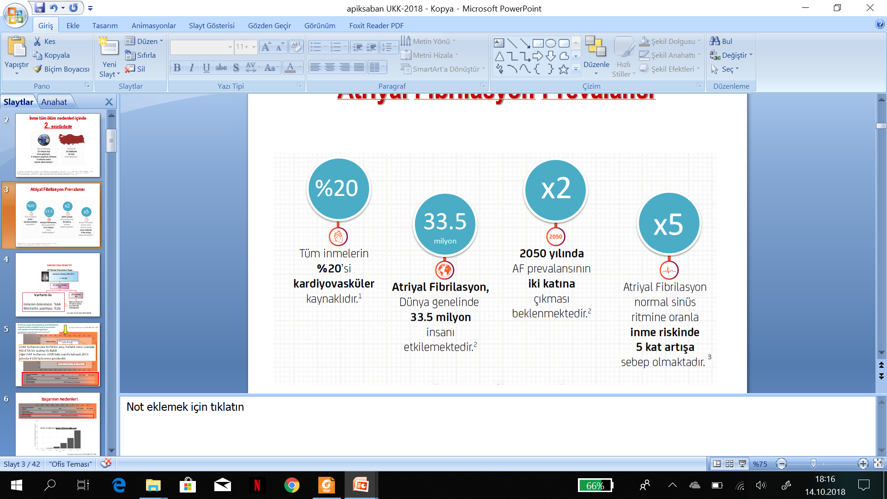
Atriyal fibrilasyon stroke riskini
5 kat arttırır
1. Aronow WS. Herz. 1991;16(6):395-404 2. Freeman WD et al. Neurol Clin. 2008;26: 1129–1160. 3. Cerasuolo J O et al. International Journal of Stroke 2017, Vol. 12(3) 222–228

Slide 5
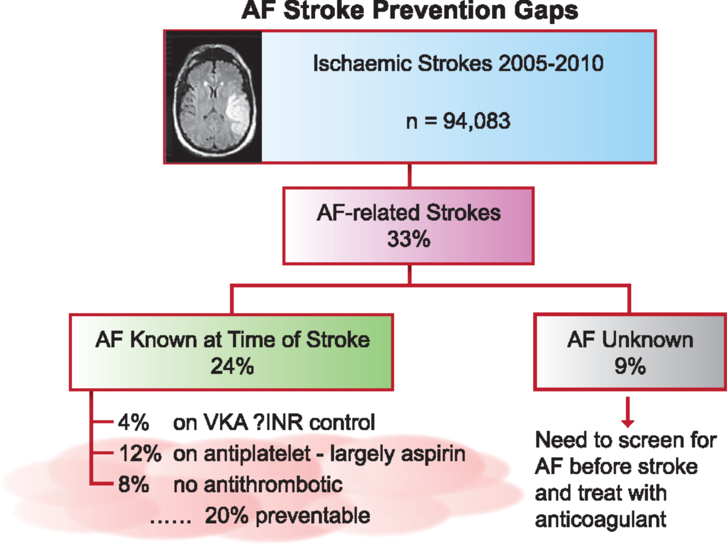
İskemik inmelerin
3’te 1’i AF ile ilişkilidir
Yıl 2005-2010
İsveç Sağlık Kayıtları
SWEDISH RISK REGISTRY
Varfarin ile
-İnmenin önlenmesi: %64
-Mortalite azalması: %26
Tedavide boşluk
Tanıda boşluk
Stroke 2014;45:2599–2605

Slide 6
Anticoagulation

Slide 7
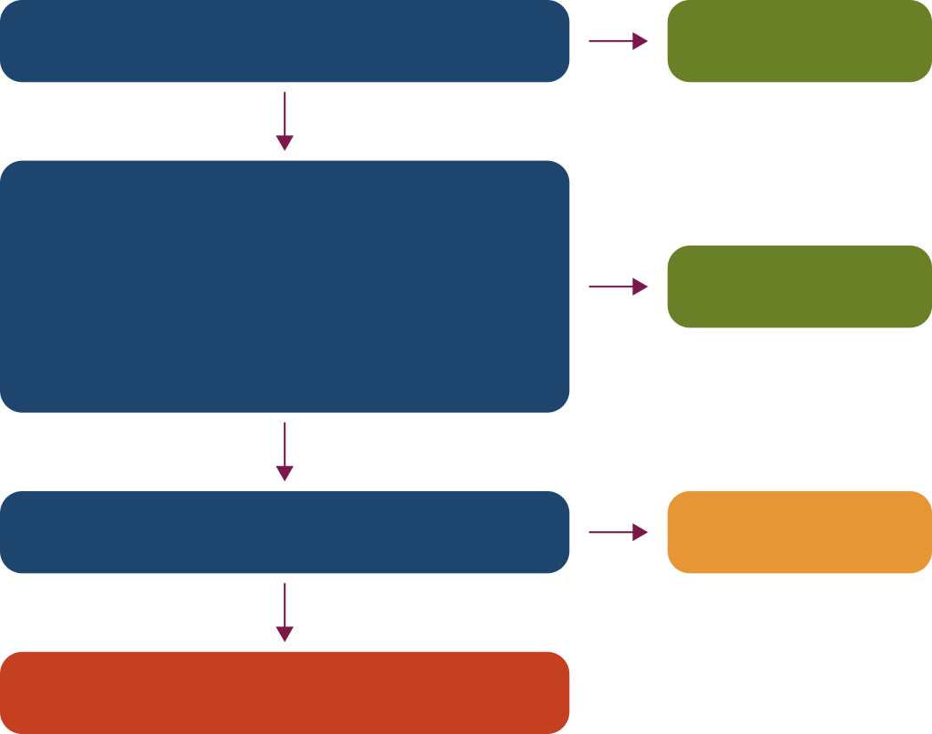
2020 Kanada Kardiyovasküler Derneği/Kanada Kalp Ritim Topluluğu Kılavuzu'na Göre OAK Kullanım Algoritması: CHADS-65¹
Evet
Yaş ≥65
OAK*
Hayır
İnme/GİA öyküsü veya
Hipertansiyon veya
Kalp yetmezliği veya
Diabetes mellitus
(CHADS₂ risk faktörleri)
Evet
OAK*
Hayır
Evet
Antiplatelet
tedavisi
Koroner veya periferik arter hastalığı
Hayır
Antitrombotik tedavi önerilmez
*Varfarine kıyasla bir DOAK kullanımı tercih edilir.
GİA: Geçici İskemik Atak; DOAK: Direk Oral Antikoagülan; OAK: Oral Antikoagülan
Referans: 1. Andrade JG., et al. Canadian Journal of Cardiology. 2020; 36:1847-1948.

Slide 8
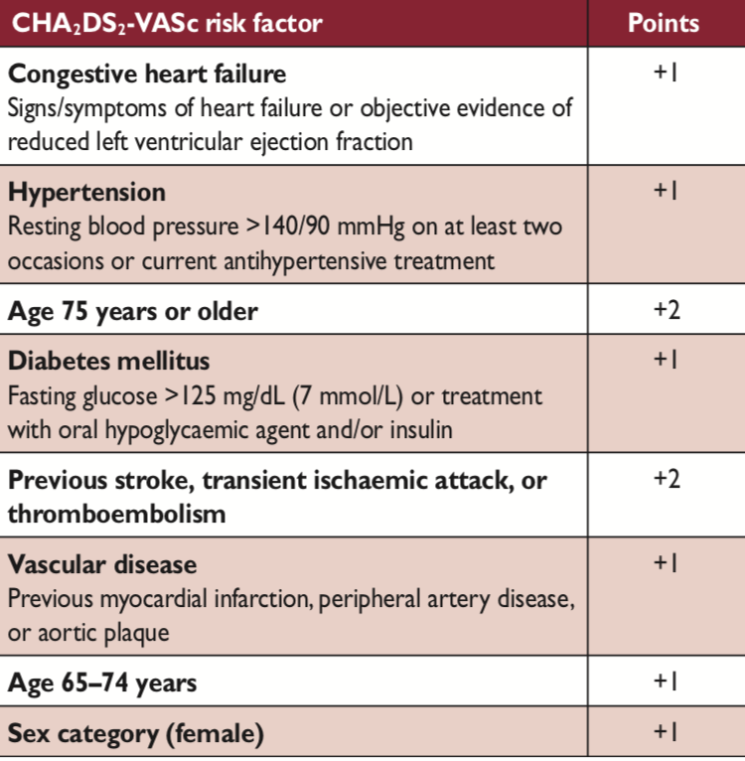
CHA₂DS₂-VASc risk skoru
Notes:
“Yüksek riskli” deneklerin öngörülmesine yönelik mevcut yaklaşımların sınırlı değere sahip olduğu göz önüne alındığında, ilk odak noktası, antitrombotik tedaviye ihtiyaç duymayan “düşük riskli” hastaların belirlenmesidir ve bu açıdan CHA₂DS₂-VASc risk skoru güçlü bir skorlama sistemidir.
CHA₂DS₂-VASc risk skorunun c istatistik değeri çeşitli kohort çalışmalarında diğer skorlama şemaları ile kıyaslanmış ( CHADS , ATRIA) ve yüksek prediktif değeri nedeniyle geniş çapta kabul görmüştür.

Slide 9
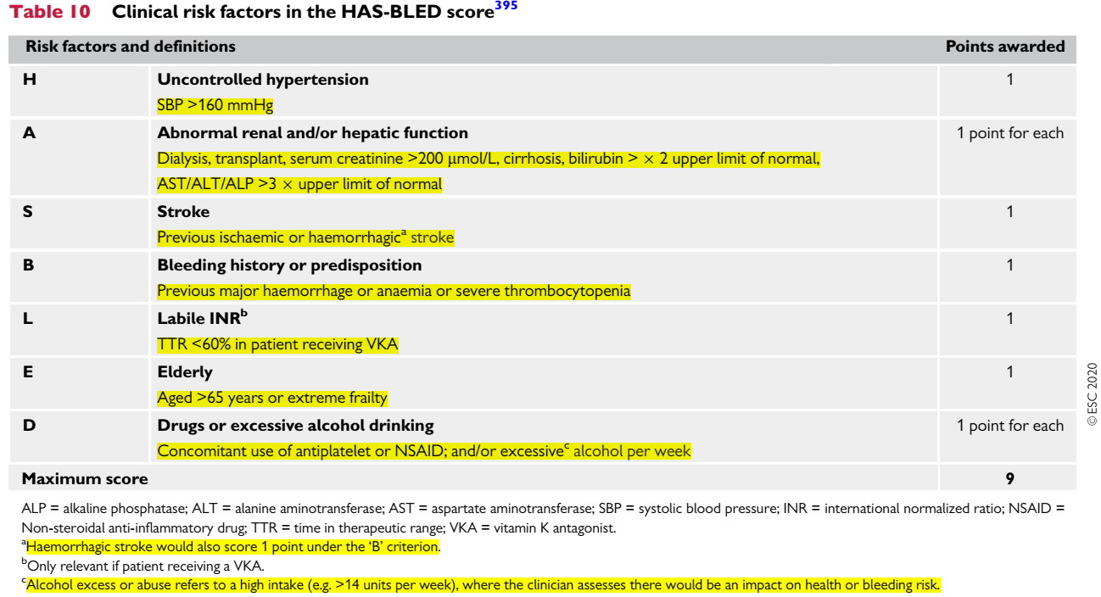

Slide 10
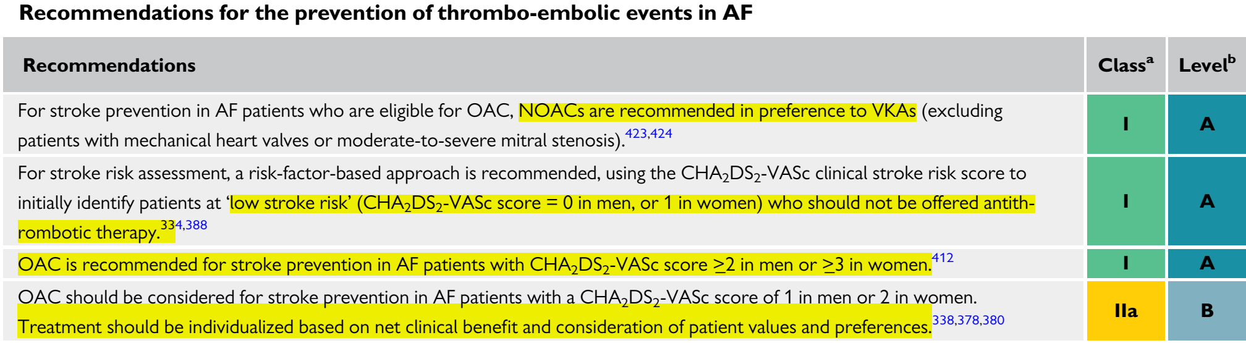
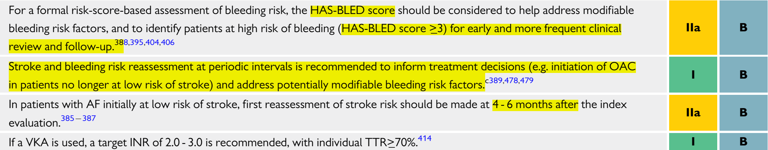

Slide 11
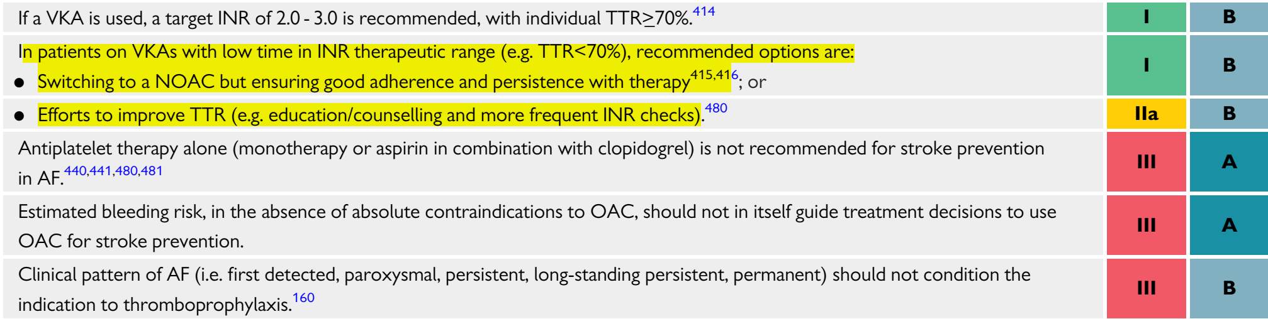
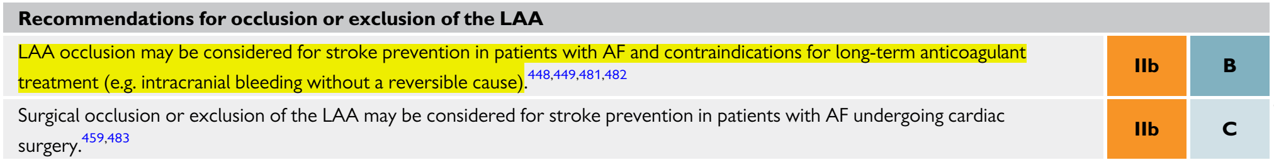

Slide 12
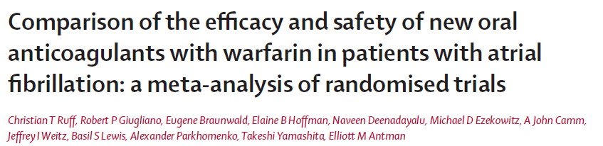
NOAK’lar, Varfarine kıyasla inme/SE riskini anlamlı düzeyde azaltır.
NOAC
(olay)
Varfarin
(olay)
İnme/ SE
RR
(%95 CI)
P değeri
Apiksaban ARISTOTLE | 212/9120 | 265/9081 |  | 0.80 (0.67–0.95) | 0.012
Dabigatran 150 mg RE-LY | 134/6076 | 199/6022 |  | 0.66 (0.53–0.82) | 0.0001
Edoksaban 60 mg ENGAGE AF-TIMI 48 | 296/7035 | 337/7036 |  | 0.88 (0.75–1.02) | 0.10
Rivaroksaban ROCKET AF | 269/7081 | 306/7090 |  | 0.88 (0.75–1.03) | 0.12
Kombine (rastgele) | 911/29312 | 1107/29 229 |  | 0.81 (0.73–0.91) | <0.0001
0.5 1.0 1.5
YOAK lehine Varfarin lehine
SE: sistemik emboli; RR: risk oranı
Bire bir çalışma mevcut olmadığından, ilaçlar arasında doğrudan karşılaştırma yapılamayabilir.
Ruff et al. Lancet 2014;383:955-62

Slide 13
NOAK’lar majör kanama açısından en az Varfarin kadar güvenlidir.
YOAK
(olay)
Varfarin
(olay)
Majör kanama
RR
(%95 CI)
P değeri
Apiksaban ARISTOTLE | 327/9088 | 462/9052 |  | 0.71 (0.61–0.81) | <0.0001
Dabigatran 150 mg RE-LY | 375/6076 | 397/6022 |  | 0.94 (0.82–1.07) | 0.34
Edoksaban 60 mg ENGAGE AF-TIMI 48 | 444/7012 | 557/7012 |  | 0.80 (0.71–0.90) | 0.0002
Rivaroksaban ROCKET AF | 395/7111 | 386/7125 |  | 1.03 (0.90–1.18) | 0.72
Kombine (rastgele) | 1541/29287 | 1802/29 211 |  | 0.86 (0.73–1.00) | 0.06
.
0.5 1.0 1.5
YOAK lehine Varfarin lehine
Bire bir çalışma mevcut olmadığından, ilaçlar arasında doğrudan karşılaştırma yapılamayabilir.
Ruff et al. Lancet 2014;383:955-62

Slide 14
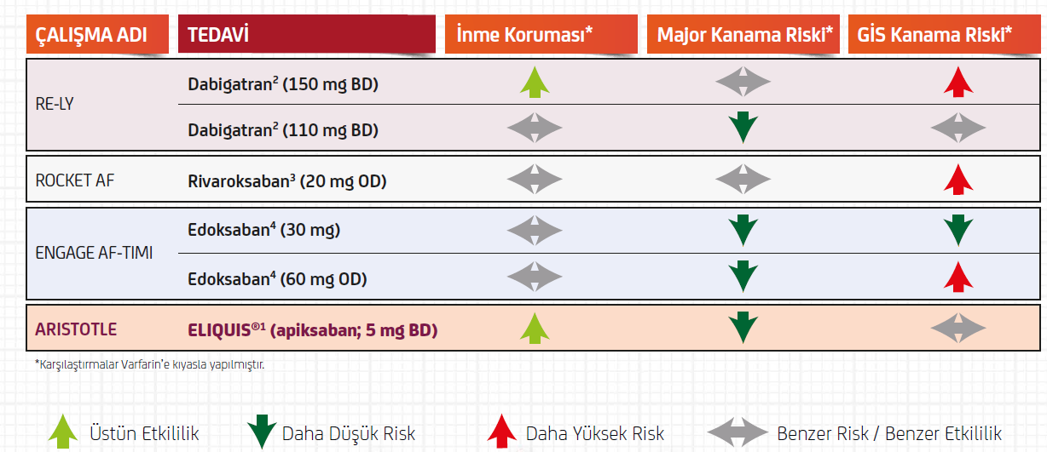
NOAK Çalışmaları: Etkinlik ve Güvenlik
1. Granger CB et al. N Eng J Med, 2011; 365: 981–992. 2. Connolly SJ, et al. N Engl J Med. 2009 Sep 17;361(12):1139-51.
3. Patel MR, et al. N Engl J Med. 2011 Sep 8;365(10):883-91. 4. Giugliano RP et al. N Engl J Med. 2013;369(22):2093-104.

Slide 15
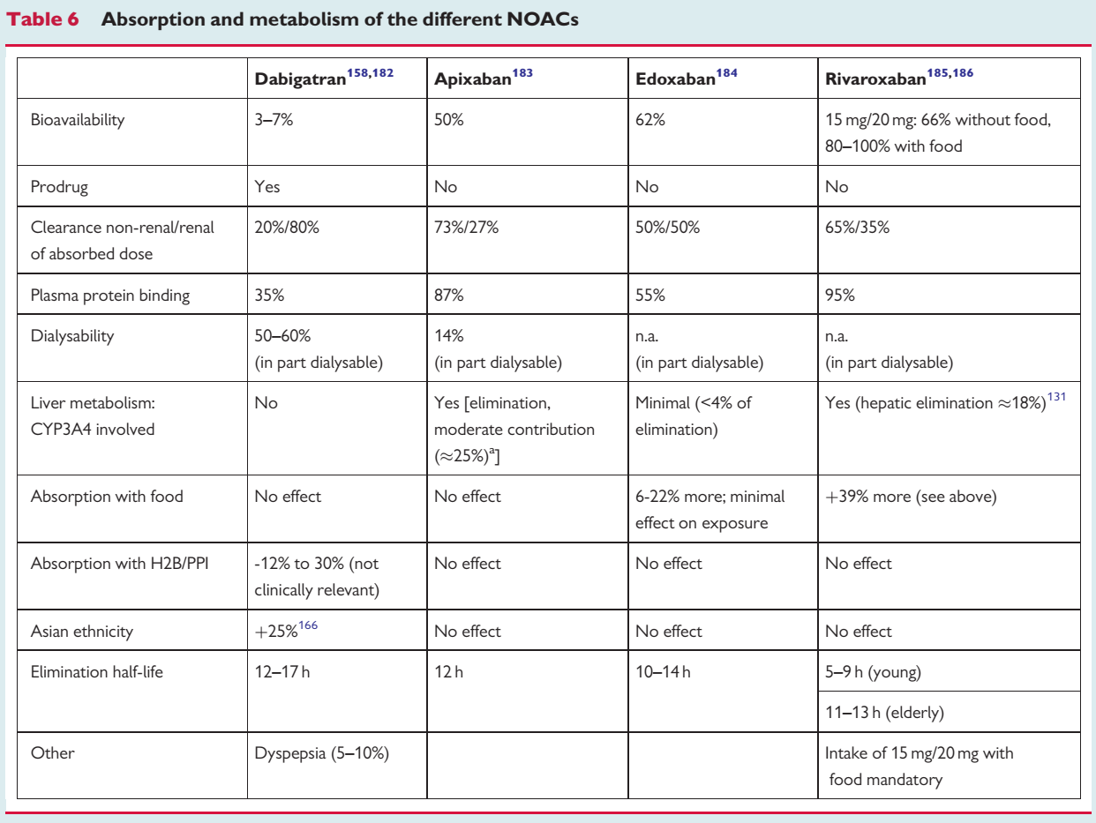
NOAK’ların Metabolizma ve Eliminasyonu

Slide 16
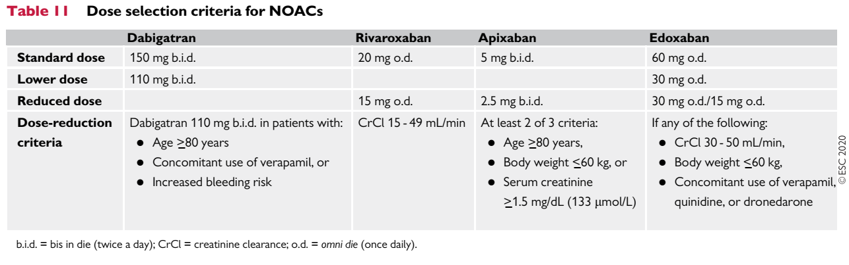
Doğru DOZ
Doz ayarlamada en etkili faktörler:
Yaş: (>75, >80),
Böbrek Fonksiyonları,
Kilo (<60 kg)
İlaç-ilaç etkileşimleri

Slide 17
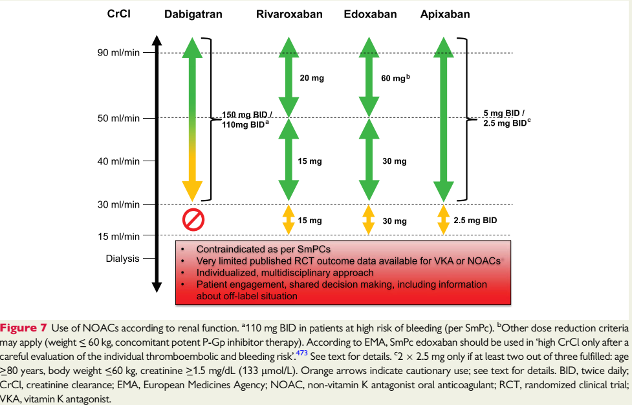
Renal Fonksiyon ve NOAK Dozu

Slide 18
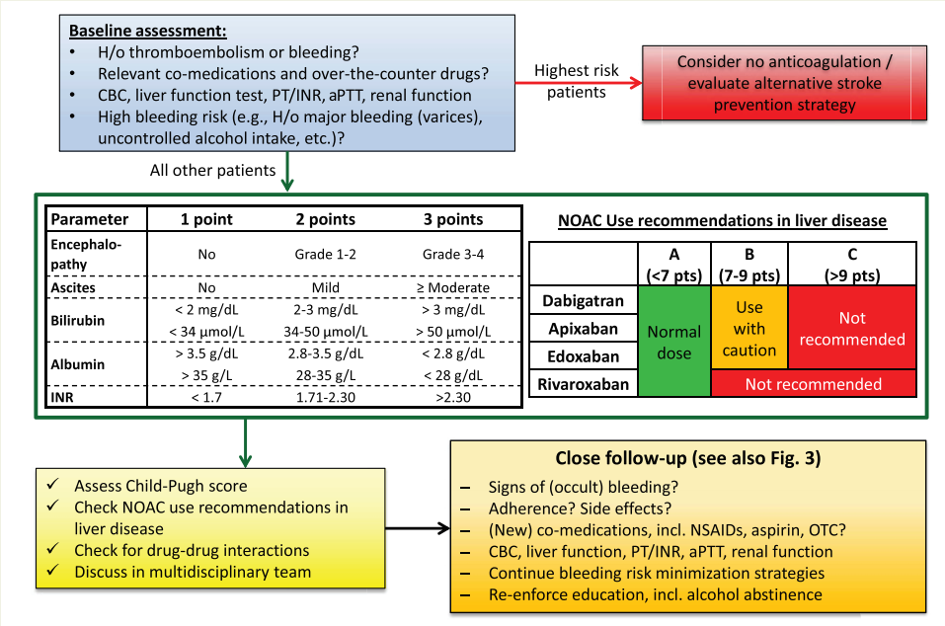
Karaciğer Fonksiyonu ve NOAK Dozu

Slide 19
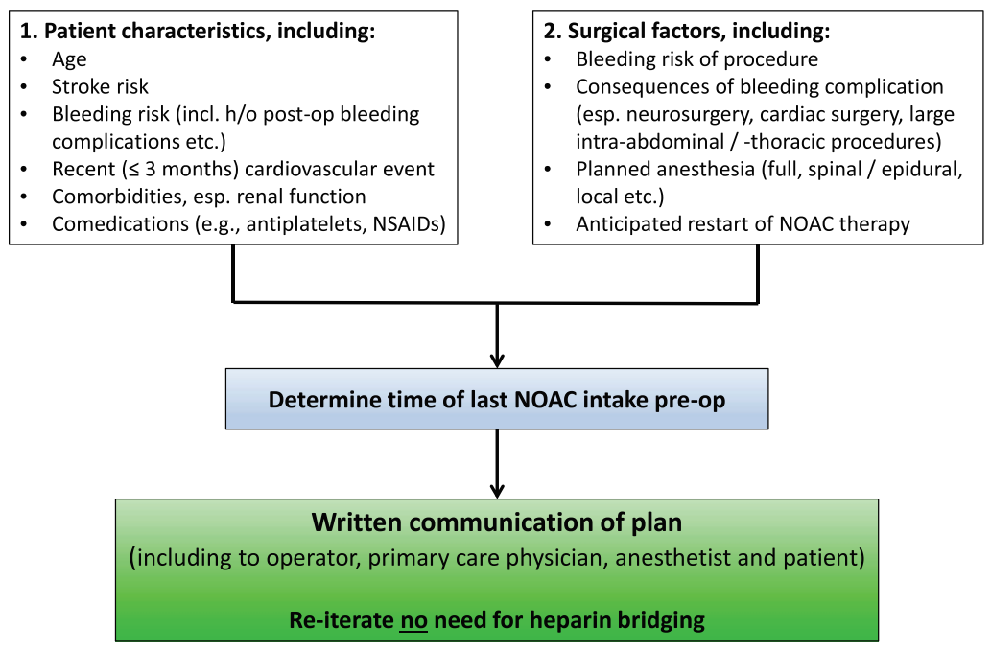
Perioperative NOAC management

Slide 20
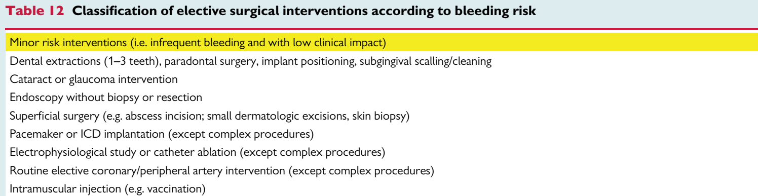
Perioperative NOAC management

Slide 21
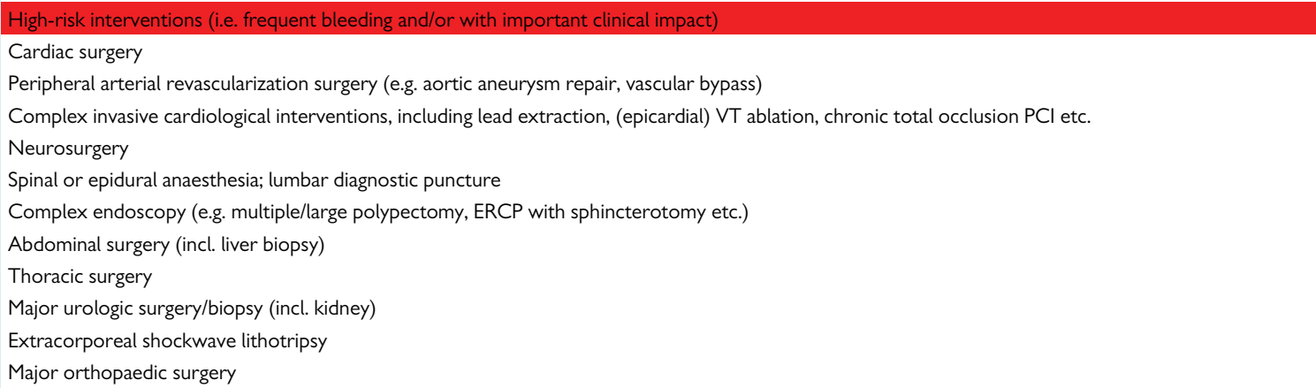
For each patient, individual factors relating to bleeding and thromboembolic risk need to be taken into account and be discussed with the operating physician and the patient

Slide 22
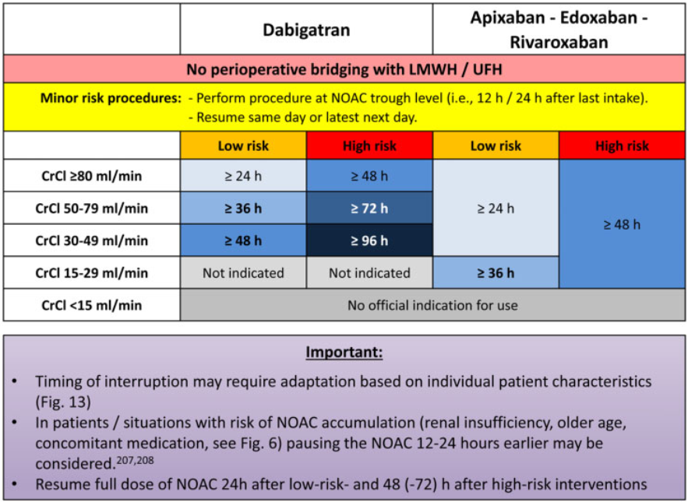

Slide 23
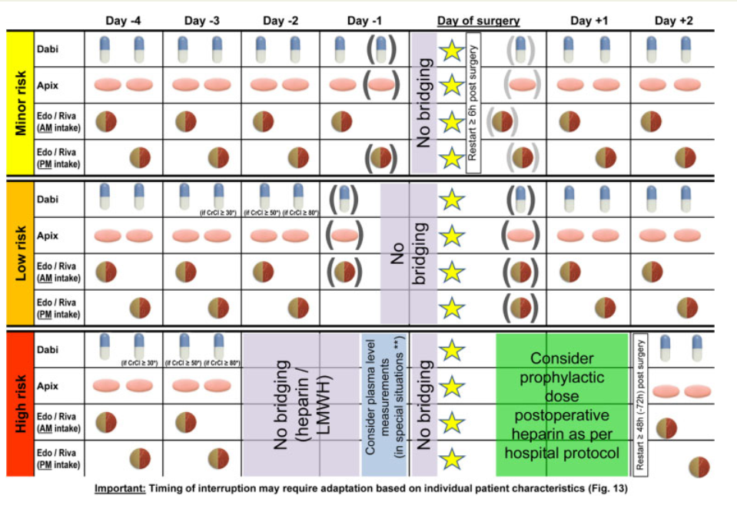
Notes:
Figure 15 Stopping and re-initiation of NOAC therapy in elective surgery. Yellow star—Time point of the intervention/operation. Parentheses indicate optional pre-/postoperative intake, especially in patients not at high risk of drug accumulation/bleeding. Consider þ24 h of interruption in situations likely resulting in increased plasma levels [e.g. body weight < 50 kg, significant interactions (see ‘Pharmacokinetics and drug-drug interactions
of NOACs’ section)]. *Intake of this dose of dabigatran if CrCl is in the indicated range; otherwise skip this dose. **Consider measurement of plasma
levels in very special situations, e.g. highest risk neurosurgery/cardiac surgery, severely impaired renal function, combination of factors predisposing
to higher NOAC levels (see ‘NOAC plasma level measurements: technical approach, indications, pitfalls’ section). Rivaroxaban needs to be taken
with food for stroke prevention in AF, which needs to be considered (also) in the post-operative setting. AF, atrial fibrillation; CrCl, creatinine clearance; NOAC, non-vitamin K antagonist oral anticoagulant
‘Perioperative Ischaemic Evaluation 2’ (POISE-2) trial, peri-operative
aspirin use did not reduce the risk of myocardial infarction (MI) or
death but increased the risk of major bleeding in 10 010 patients at
risk for vascular complications (one third with a history of vascular
disease).219 However, whether these results translate to patients at
very high risk of coronary events during perioperative interruption of
NOAC therapy remains unclear. A strategy with initiation of aspirin
therapy pre-operatively, performance of the operation under continued aspirin (with suspended NOAC), and re-initiation of NOAC
therapy post-operatively (with discontinuation of aspirin therapy)
may be evaluated and based on a multidisciplinary team decision.
Again, further studies are required to help guide the perioperative
management in these high-risk situations

Slide 24
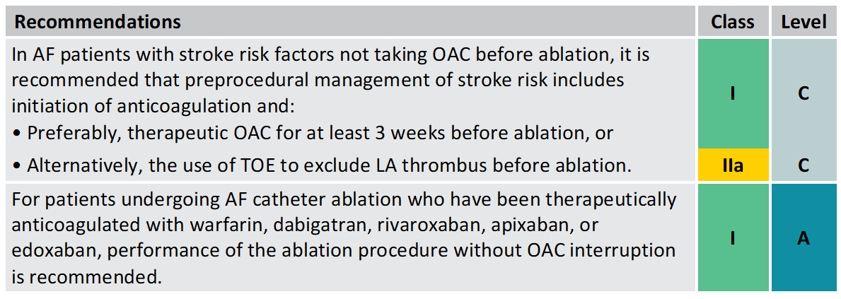
NOAC management before and after AF ablation
Hindricks G., et al. European Heart Journal (2020) 00, 1-125.

Slide 25
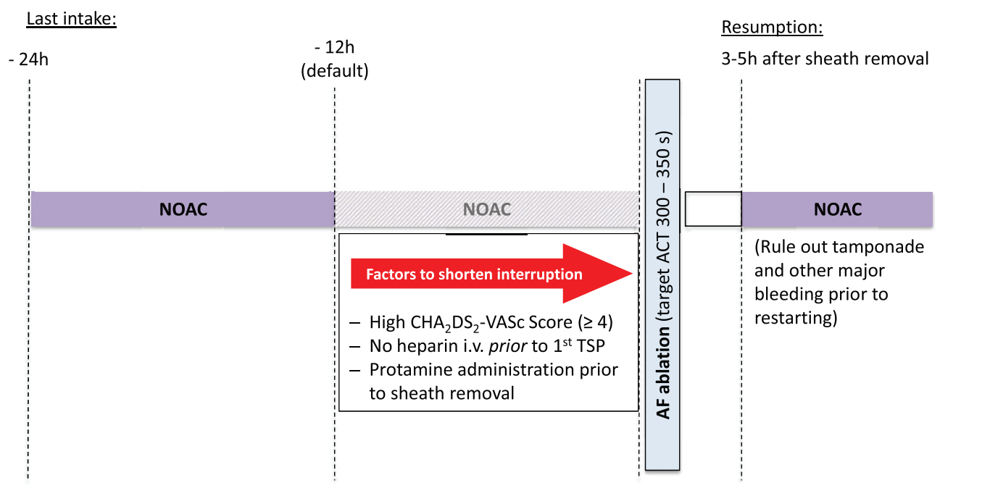
Peri- ablation NOAC Management

Slide 26
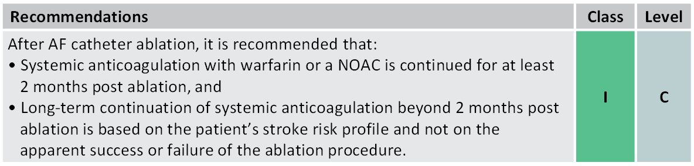
NOAC management before and after AF ablation
Hindricks G., et al. European Heart Journal (2020) 00, 1-125.

Slide 27
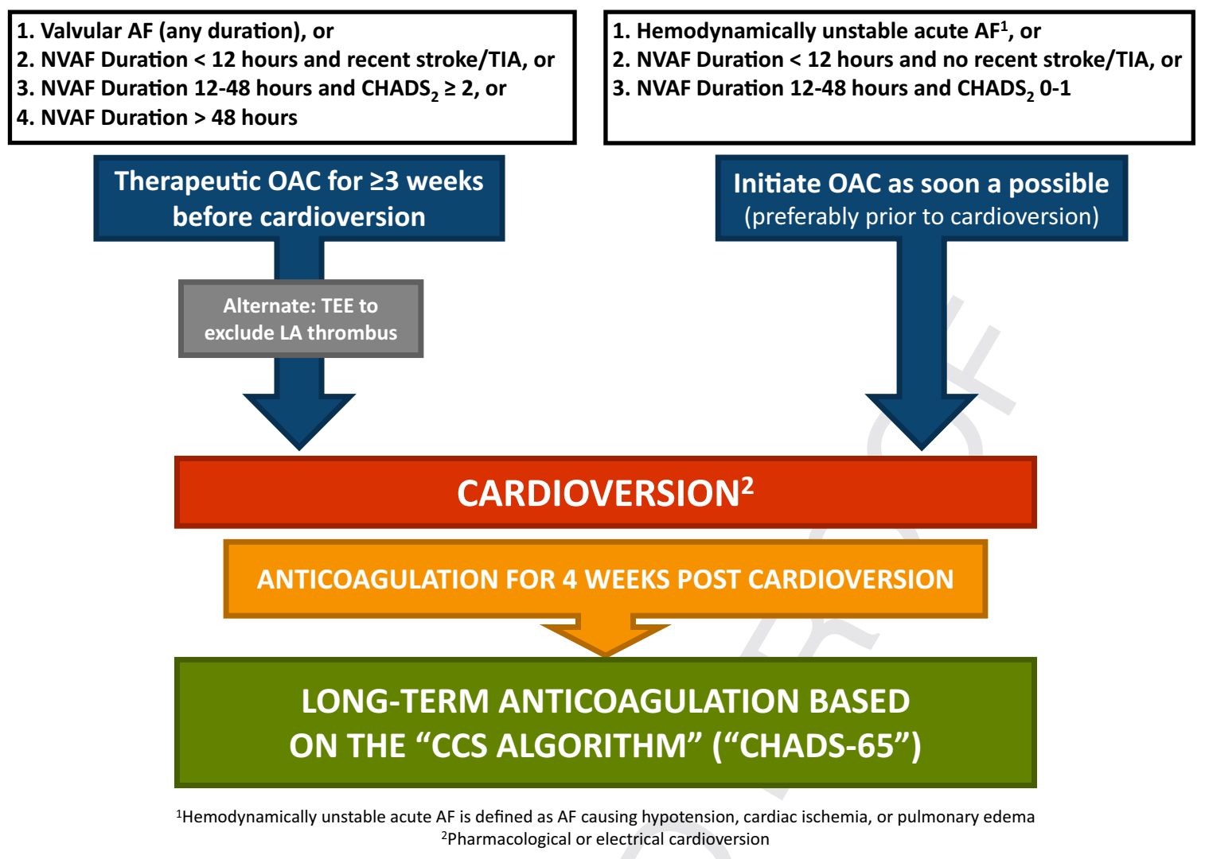
Kardiyoversiyon
Kanada 2020 A.F kılavuzu

Slide 28
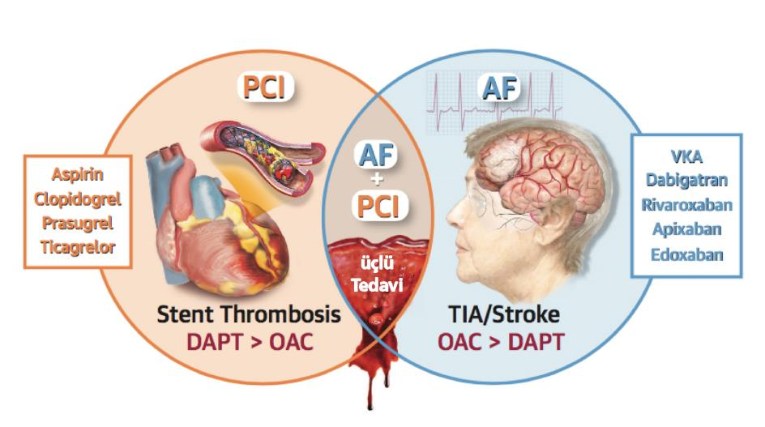
AF and PCI %15
VKA
NOAK’lar:
Dabigatran
Rivaroksaban
Apiksaban
Edoksaban
Aspirin
Klopidogrel
Prasugrel
Tikagrelor
Stent Trombozu
TIA/İnme
OAK > DAPT
DAPT > OAK
Bleeding risk
Referans: Capodanno D, Huber K, Mehran R, et al. Management of Antithrombotic Therapy in Atrial Fibrillation Patients Undergoing PCI: JACC State-of-the-Art Review. J Am Coll Cardiol 2019; 74(1): 83-99.

Slide 29
PIONEER-AF PCI¹
RE-DUAL²
ENTRUST-AF³
AUGUSTUS⁴
2.100 hasta
2.800 hasta
1.500 hasta
4.600 hasta
Rivaroksaban
15 mg
Dabigatran
150 & 110 mg
Edoksaban
60 mg
Apiksaban
5 mg
2’li
vs.
3’lü
2’li
vs.
3’lü
2’li
vs.
3’lü
2’li
vs.
2’li
3’lü
vs.
3’lü
Kanama
Etkinlik
Kanama
Etkinlik
Kanama
Etkinlik
Üstün
Üstün
Benzer
150
Benzer
Benzer
Benzer
Kanama
Etkinlik
Üstün
Kanama
Etkinlik
Benzer
Üstün
110
Benzer
NOT: Çalışmalar etkinlik sonlanımları için yeterli güce sahip değil.
1. Gibson et al., PIONEER-AF PCI, N Engl J Med. 2016 Dec 22;375(25):2423-2434. 2. Cannon et al., RE-DUAL PCI, N Engl J Med. 2017 Oct 19;377(16):1513-1524. 3. Vranckx et al., ENTRUST-AF PCI, The Lancet, Published Online, Sep 3, 2019. 4. Lopes et al., AUGUSTUS,. N Engl J Med. 2019;doi: 10.1056/NEJMoa1817083

Slide 30
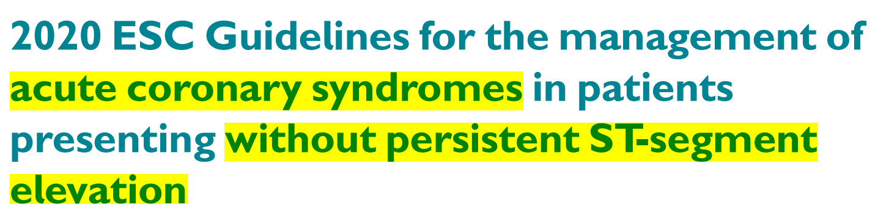
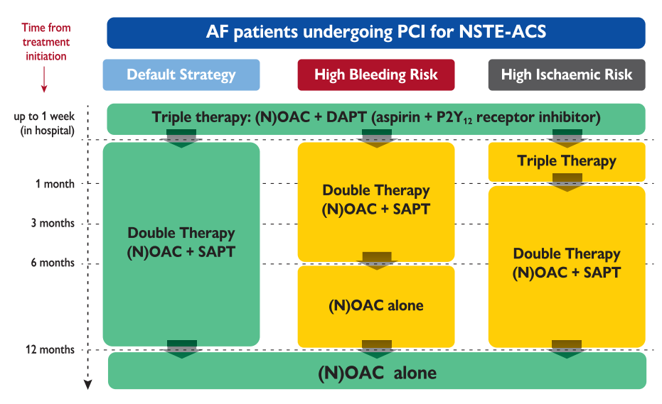
Notes:
Figure 8 Algorithm for antithrombotic therapy in non-ST-segment elevation acute coronary syndrome patients with atrial fibrillation undergoing percutaneous coronary intervention or medical management. Green (class I) and yellow (class IIa) colours denote the classes of recommendation. OAC: preference for a NOAC over VKA for the default strategy and in all other scenarios if no contraindications. For both TAT and DAT regimens, the
recommended doses for the NOACs are as follows:
1) Apixaban 5 mg b.i.d.241
2) Dabigatran 110 mg or 150 mg b.i.d.238
3) Edoxaban 60 mg/d
4) Rivaroxaban 15 mg or 20 mg/d240
At variance with the default strategy, in patients with
HBR, DAT should be shortened to 6 months by withdrawing the
ongoing antiplatelet therapy; while in patients with high coronary
ischaemic risk, TAT should be prolonged up to 1 month, followed by
DAT for up to 12 months. There is currently limited evidence to support the use of OACs with ticagrelor or prasugrel as dual therapy
after PCI as an alternative to TAT.241,245 Following coronary stenting,
DAPT with aspirin and ticagrelor or prasugrel, without OAC, may be
considered as an alternative to TAT in patients with high ischaemic
risk NSTE-ACS and AF and one non-sex stroke risk factor within the
first 4 weeks.

Slide 31

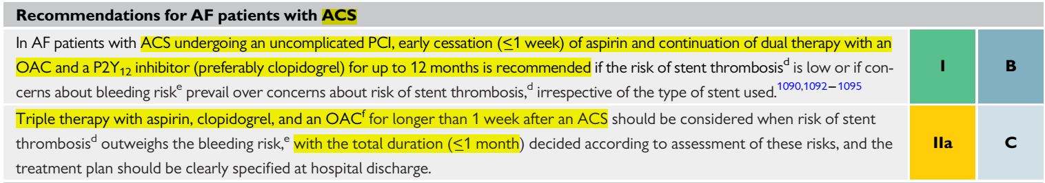
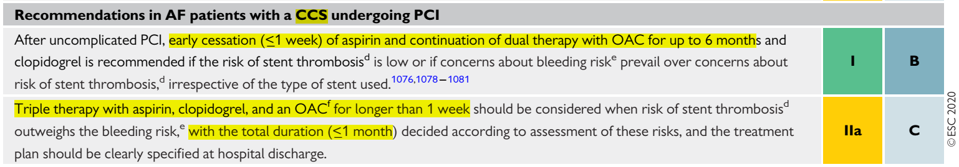
How Long?
TAT-DAT

Slide 32
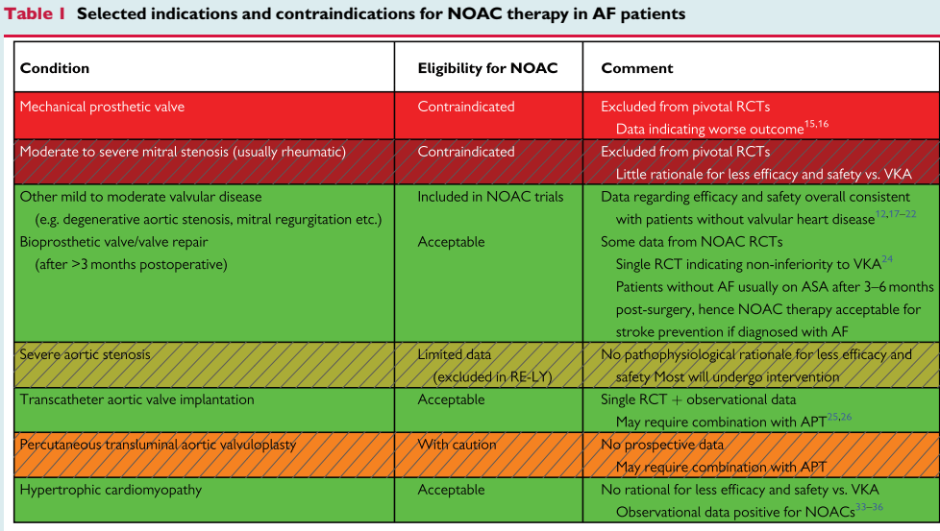
EHRA-NOAC-2021

Slide 33
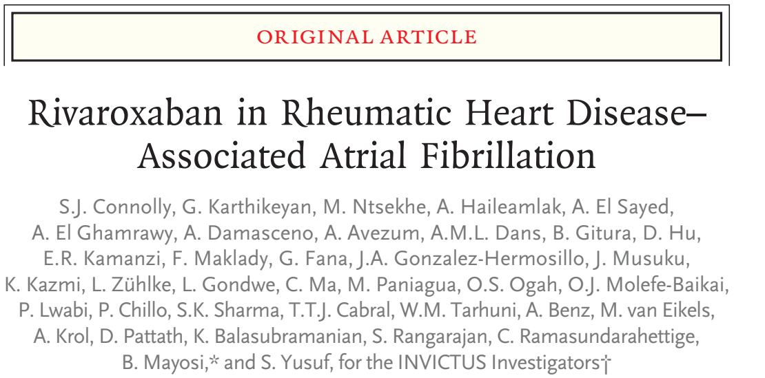
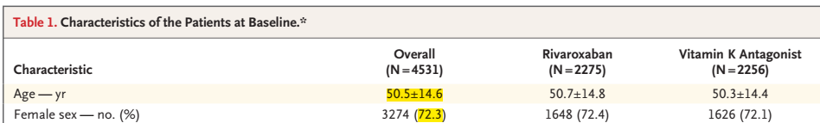
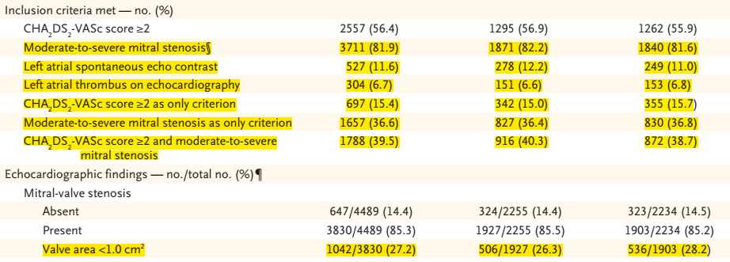
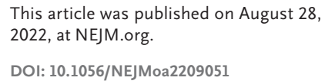

Slide 34
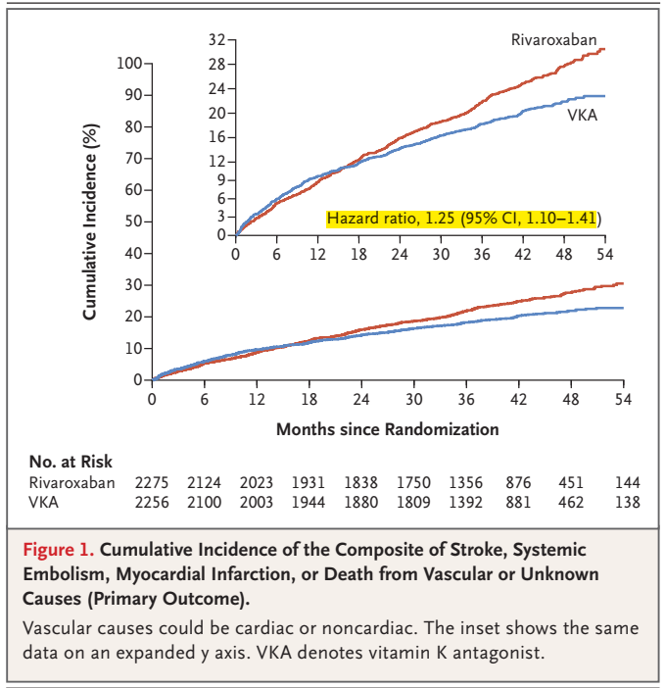
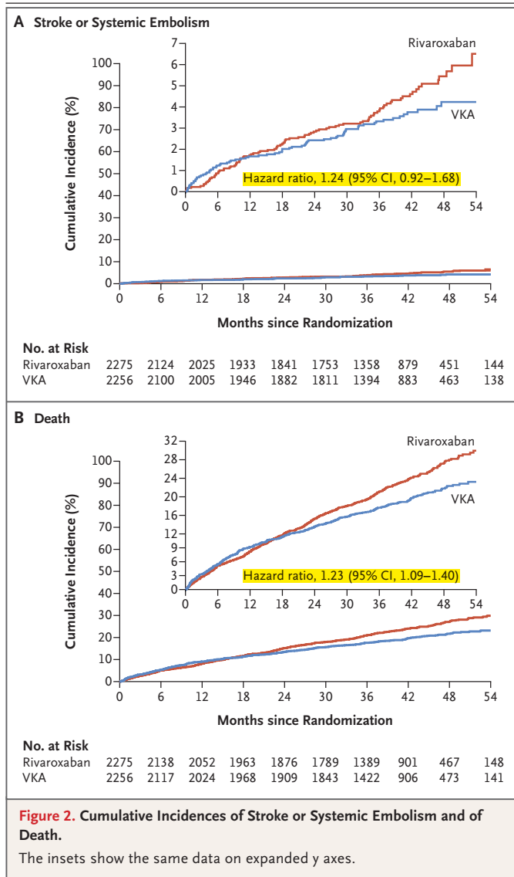

Slide 35


